Slide 1

Sprint week!!!
PowerPoint by, Alex, Clay, & Dillon

Slide 2
European Commission could move to break up Google AD’s Empire
By: Alex Dmitriiev
Reddit NSFW communities
By: Clay Tuck
Intels first Quantum Chip
By: Dillon Regular

Slide 3
First up alex
Qwert yui opasdf

Slide 4
European Commission could move to break up Google AD’s Empire
European Commission Investigates Google for potential Antitrust Violations in Online advertising Industry

Slide 5
Summary
The European Commission has announced a preliminary finding that Google may have violated EU antitrust law.
The investigation focuses on Google's control over the online advertising industry.
The Commission suggests that Google's dominance threatens free competition and could require divestment of its advertising business.

Slide 6
Allegations against Google's Control in Advertising Technology Market
The Commission accuses Google of informing its AdX ad exchange of competitors' best bids in advance, giving it an unfair advantage.
Google's programmatic ad buying tools prioritize its own services, funneling business to AdX over rival ad exchanges.
This behavior consolidates Google's market position, allowing it to charge artificially high fees for its advertising services.

Slide 7
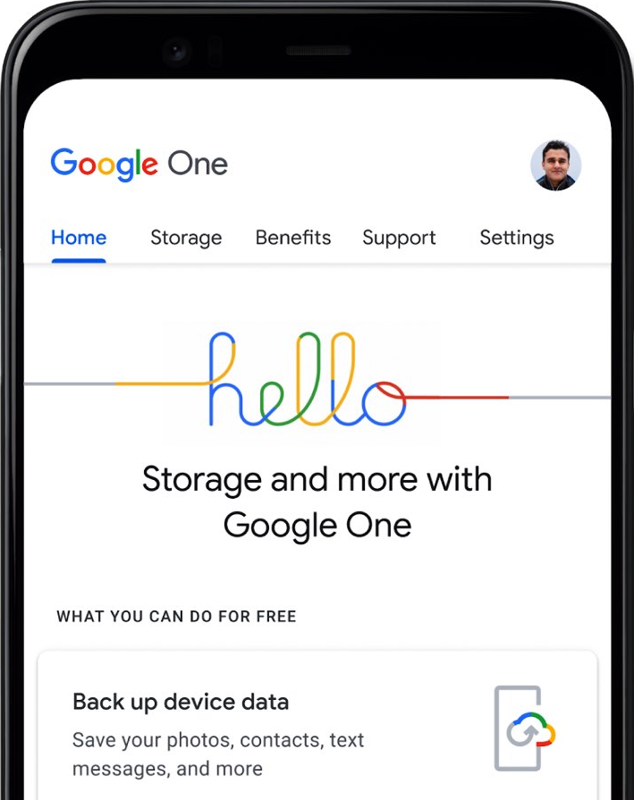
Potential Consequences and Google's Response
Violation of EU antitrust law could result in fines of up to 10% of Google's annual global turnover.
Google's annual revenue heavily relies on its advertising business, making the European Commission's investigation a significant challenge.
Google has stated that it disagrees with the Commission's view and will respond accordingly, indicating its intention to contest the allegations.

Slide 8
Next to bat Clay
Reddit nsfw communities

Slide 9
Lastly Dillon
Intel quantum computing

Slide 10

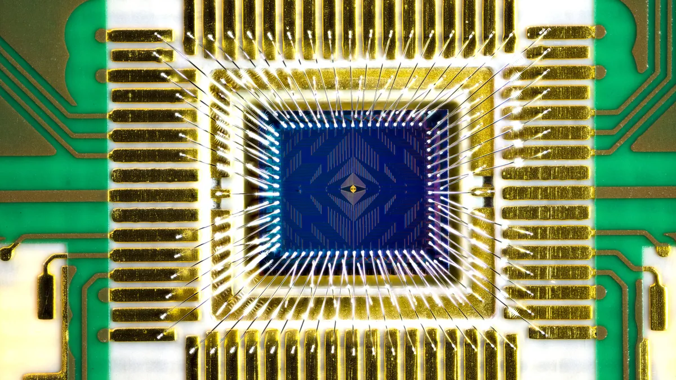

Intel quantum computing
Intel creates a 12-Qubit computer chip. Considered to be a low amount.
“Late to the party” but hopeful for a bright future at the top
Unlike rival companies, intel makes its qubits from individual electrons housed in the style of the normal CPU.
This thing reminds me of something… What could it be?

Slide 11


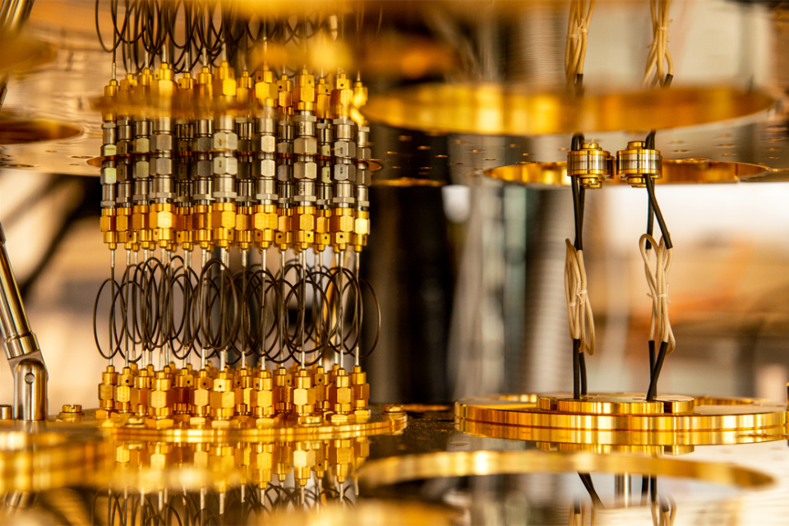
-Utilizes quantum mechanic to solve complex issues
-Qubits represent Quantum Particles.
-Qubits create the idea of quicker more precise information over the traditional “Bit”
what is quantum computing?

Slide 12
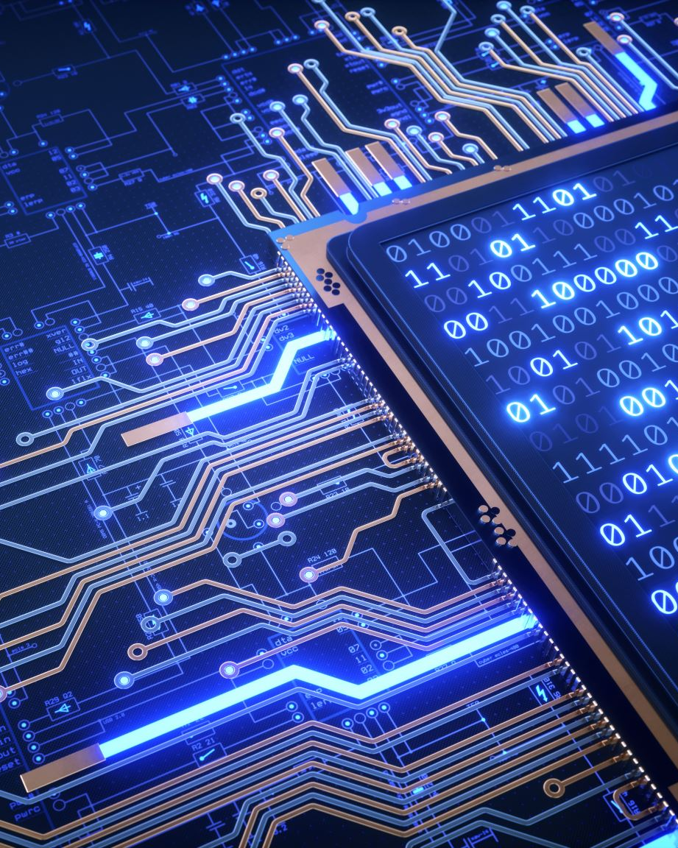
Why is this important?
AS STATED BEFORE, INTEL DID SOMETHING SPECIAL BY UTILIZING THE FORMATTING AND STRUCTURE OF THE REGULAR CPU.
Up to this point, quantum computers and household computers were separate things. Intel unified them! Which means that over the next 10 years or so, household quantum CPU’s will be a real thing!

